Slide 1

Demographic Data in Integrated Administrative Data Systems:
Seeking Experiential Knowledge to
Inform Race and Gender Data
We want to learn from your experience!
Module 2 of 5
Public Interest Technology University Network Year 6 Challenge
January 2026
Notes:
I’m excited to talk to you today about an important and impactful facet of data collection. What do we do when the data we collect ccontradicteach other?
Today we are going to talk about administrative data.
Administrative data is collected to run social programs, such as homeless services, food assistance, and others. When administrative data (from housing services, food assistance and schools) is linked, people’s interactions across systems and over time can be traced. This linked data can be used to implement better programs and address social needs more effectively.
Today we’ll focus on how administrative data is linked across systems and how demographic information like race and gender is represented in the data. We’ll also see how experiential knowledge of people represented in these systems can help us better interpret the data and use it to advance social good.

Slide 2
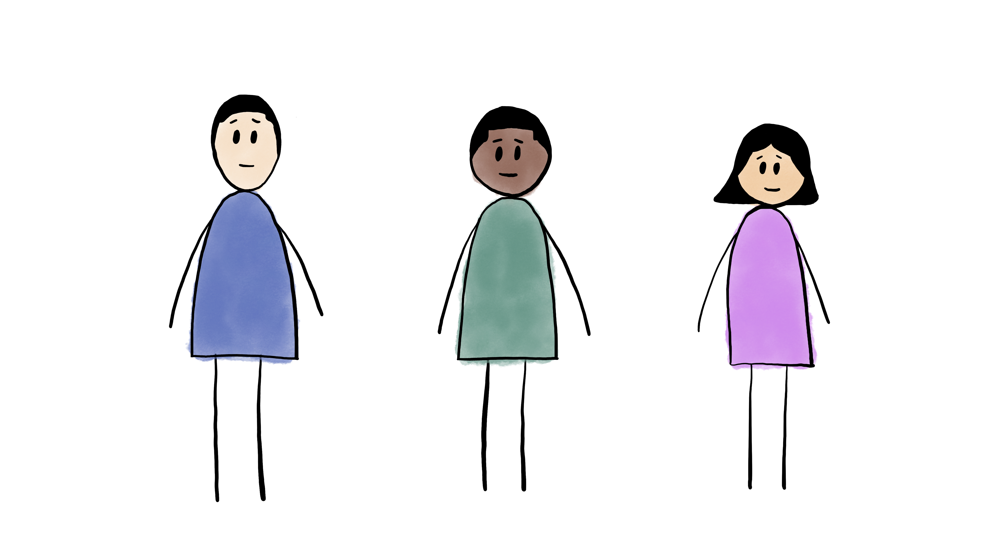
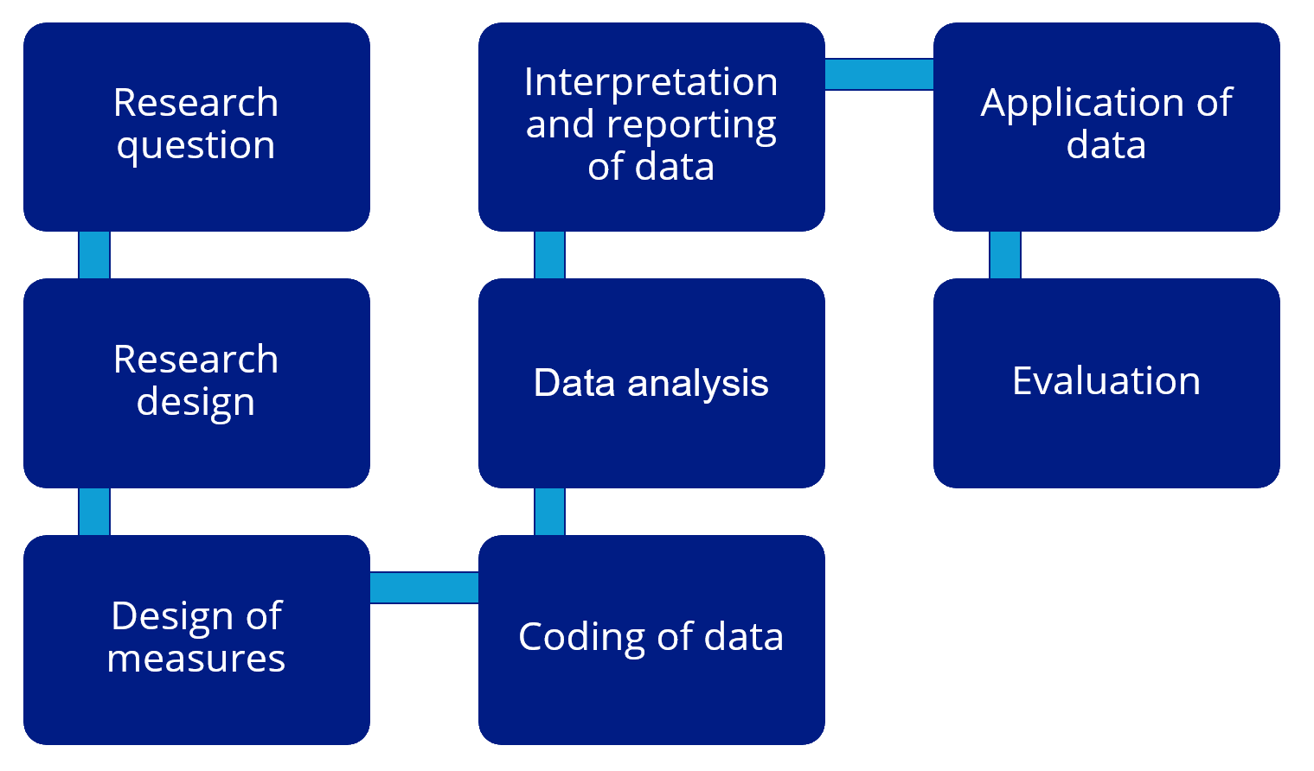


Module 3
An illustration of Label Bias in Homelessness
Data Analytics
Module 5
Recommendations to address constraints and bias in Integrated Data Analytics
2 2
Module 1
FAIR2: A framework for integrating community knowledge in data analytics and addressing discrimination bias
Module 4
An illustration of
Collider Bias in
housing research
Module 2
Demographic Data in Integrated Data Systems: Seeking Experiential Knowledge to Inform Race and Gender Data

Slide 3

Meet Aaron
Notes:
To illustrate administrative data, let’s first talk about Aaron.

Slide 4
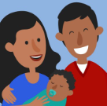
2005
Birth
HMIS - Family Profile
Race | Black
Ethnicity | Unknown
Gender | Male
Aaron doesn’t know much about their early years, though they know their parents had them very young and struggled to make ends meet. Neither of Aaron’s parents had any family that lived nearby, so Aaron knows that they sometimes got help from food pantries and federal programs, like SNAP.
SNAP - Family Profile
Race | Black
Ethnicity | Non-Hispanic
Gender | Male
HMIS - Family Profile
Race | Multi-Racial
Ethnicity | Non-Hispanic
Gender | Male
SNAP - Family Profile
Race | Multi-Racial
Ethnicity | Non-Hispanic
Gender | Male
Notes:
Aaron was born 2006, but Aaron doesn’t know much about their early years, though they know their parents had them very young and struggled to make ends meet. Neither of Aaron’s parents had any family that lived nearby, so Aaron knows that they sometimes got help from local food pantries and federal programs, like SNAP.
On the left side of the slide, we can see how Aaron’s demographic information was recorded each time their family received any type of federal benefit. We can also see that Aaron’s family interacted with the homelessness management information system HMIS, perhaps receiving housing assistance, though it sounds like Aaron may not have known about this. We can also see that it looks like Aaron’s race was recorded slightly different, sometimes as Black, sometimes as Multi-racial.
We can also see that data was recorded about AARON’S family’s via SNAP which is Supplemental nutrition program or food assistance data.
So here we are looking at data about Aaron collected by housing and food assistance programs over the years.

Slide 5

2011
1st Grade
School - Elementary
Race / Ethnicity | Multi-Racial
Gender | Male
Throughout elementary school and middle school, Aaron’s family moved around a lot based on where their parents could find work. Aaron remembers that sometimes money would get tight around the end of the month, but their parents always found a way to get by.
SNAP - Family Profile
Race | Multi-Racial
Ethnicity | Non-Hispanic
Gender | Male
School - Middle School
Race / Ethnicity | Black
Gender | Male
2020
9th Grade
Notes:
Throughout elementary school and middle school, Aaron’s family moved around a lot based on where their parents could find work. Aaron remembers that sometimes money would get tight around the end of the month, but their parents always found a way to get by.
Now that Aaron has entered school, we see how their demographic information was also recorded in the school system. Note that the school only has one code that encompasses both race and ethnicity, where other systems record race and ethnicity separately.
We we see there are three different administrative databases that contain information about Aaron, but the information recorded about Aaron’s race is not the same.

Slide 6
2020
9th Grade
Aaron is very happy that their family was able to spend all four years of high school in the same city, though. They finally felt like they fit in after making friends with a group of other LGBTQ+ students and started to explore both their gender identity and racial identity. Having parents from two different racial backgrounds, Aaron was never quite sure where they fit in. Aaron’s high school friends helped them form their own understanding of their identities. After high school, Aaron’s parents moved again, but Aaron decided to stay in the same city that they now called home.
SNAP - Family Profile
Race | Multi-Racial
Ethnicity | Non-Hispanic
Gender | Male
School - High School
Race / Ethnicity | Black
Gender | Other
2023
12th Grade
Notes:
Aaron is very happy that their family was able to spend all four years of high school in the same city, though. They finally felt like they fit in after making friends with a group of other LGBTQ+ students and started to explore both their gender identity and racial identity. Having parents from two different racial backgrounds, Aaron was never quite sure where they fit in. Aaron’s high school friends helped them form their own understanding of their identities. After high school, Aaron’s parents moved again, but Aaron decided to stay in the same city that they now called home.
This is the first time that we see Aaron reporting their own demographic information on the left side of the slide – We see that they self-reported their race/ethnicity and gender identities to the school system starting in high school. Note how their gender identity changed to “Other gender” when they self-reported it as they were going through developmental stages of identity development.

Slide 7
2024
HS Graduation
SNAP - Adult Profile
Aaron knew they wanted to get a college education but wanted to earn some income as well. So, they immediately started a part-time job at a local restaurant while applying for college. It wasn’t enough money to make ends meet, so Aaron found themselves applying for Supplemental Nutrition Assistance Program (SNAP) services. With SNAP and their part-time job, Aaron was able to rent a small apartment and take a couple college classes up until a few weeks ago. Aaron had been growing more confident in their gender expression and identity, but unfortunately that brought on multiple ongoing customer complaints at the restaurant they worked at. Unfortunately, Aaron’s manager thought it would be easier to let Aaron go and appease the customers, so Aaron suddenly became unemployed with no way to pay next month’s rent.
Race | Black
Ethnicity | Non-Hispanic
Gender | Unknown
SNAP - Adult Profile
Race | Black
Ethnicity | Non-Hispanic
Gender | Unknown
HMIS – Adult Profile
Race | Black
Ethnicity | Non-Hispanic
Gender | Non-Binary
2025
Present
HMIS – Adult Profile
Race | Black
Ethnicity | Non-Hispanic
Gender | Male
Notes:
Aaron knew they wanted to get a college education but wanted to earn some income as well. So, they immediately started a part-time job at a local restaurant while applying for college. It wasn’t enough money to make ends meet, so Aaron found themselves applying for Supplemental Nutrition Assistance Program (SNAP) services. With SNAP and their part-time job, Aaron was able to rent a small apartment and take a couple college classes up until a few weeks ago. Aaron had been growing more confident in their gender expression and identity, but unfortunately that brought on multiple ongoing customer complaints at the restaurant they worked at. Unfortunately, Aaron’s manager thought it would be easier to let Aaron go and appease the customers, so Aaron suddenly became unemployed with no way to pay next month’s rent.

Slide 8
2024
HS Graduation
SNAP - Adult Profile
Race | Black
Ethnicity | Non-Hispanic
Gender | Unknown
Aaron has applied for some housing assistance programs but will soon lose the apartment. Aaron has been looking into homeless shelters in the area but is concerned they won’t feel safe at the men’s shelter and won’t be allowed in the women’s shelter. On top of all of that, Aaron never got around to changing their ID and documents from “male” and isn’t sure what to do about all the forms they now have to fill out for housing assistance.
SNAP - Adult Profile
Race | Black
Ethnicity | Non-Hispanic
Gender | Unknown
HMIS – Adult Profile
Race | Black
Ethnicity | Non-Hispanic
Gender | Non-Binary
2025
Present
HMIS – Adult Profile
Race | Black
Ethnicity | Non-Hispanic
Gender | Male
Notes:
Now that Aaron is an adult, we see that all of their information from high school graduation onward is self-reported. We also see that Aaron’s gender differs based on the system they are in: Unknown for SNAP, Nonbinary then Male for HMIS.
Aaron has applied for some housing assistance programs but will soon lose the apartment. Aaron has been looking into homeless shelters in the area but is concerned they won’t feel safe at the men’s shelter and won’t be allowed in the women’s shelter. On top of all of that, Aaron never got around to changing their ID and documents from “male” and isn’t sure what to do about all the forms they now have to fill out for housing assistance.

Slide 9
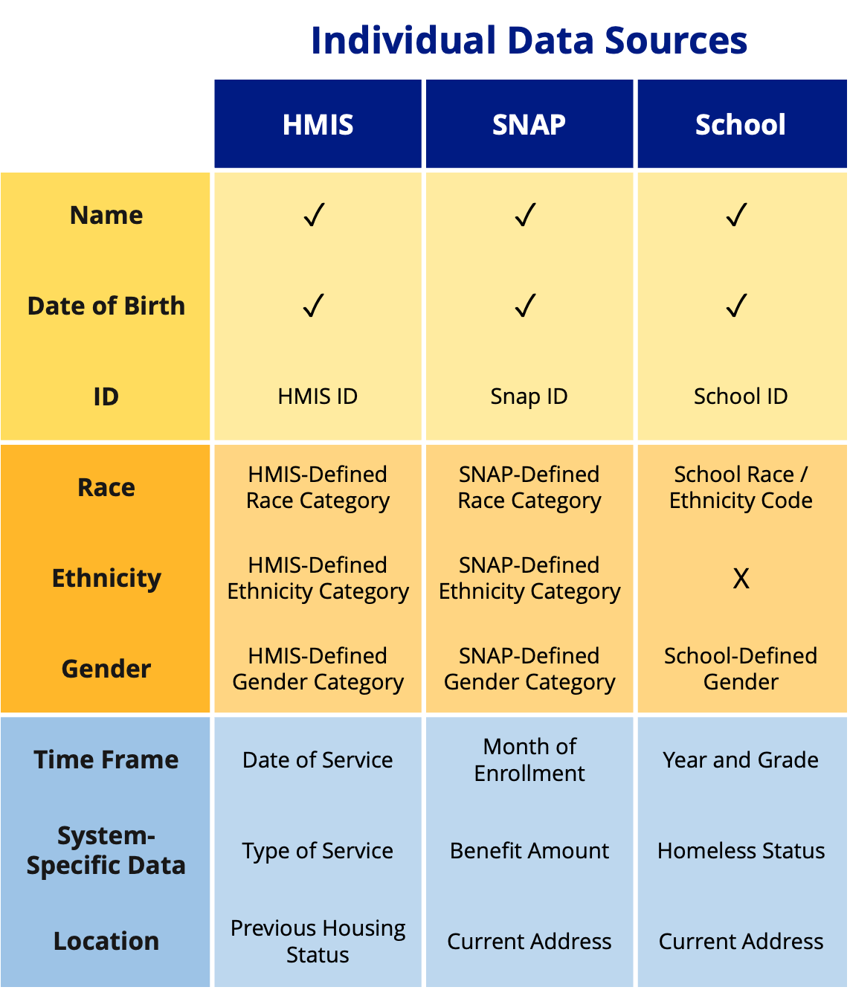
What is Integrated Administrative Data (IDS)?
 | Individual Data Sources
 | HMIS | SNAP | School
Name | $$✓$$ | $$✓$$ | $$✓$$
Date of Birth | $$✓$$ | $$✓$$ | $$✓$$
ID | HMIS ID | Snap ID | School ID
Race | HMIS-Defined Race Category | SNAP-Defined Race Category | School Race / Ethnicity Code
Ethnicity | HMIS-Defined Ethnicity Category | SNAP-Defined Ethnicity Category | X
Gender | HMIS-Defined Gender Category | SNAP-Defined Gender Category | School-Defined Gender
Time Frame | Date of Service | Month of Enrollment | Year and Grade
System-Specific Data | Type of Service | Benefit Amount | Homeless Status
Location | Previous Housing Status | Current Address | Current Address
Linked administrative data is created when information about the same person from different public systems, such as homelessness services (HMIS), food assistance (SNAP), and schools, is:
Cleaned
Matched using shared info like name and date of birth
Connected via a unique ID
Clean & Standardize Records
1.
Link Records by Name
& Date of Birth
(When available, check parent / guardian’s name, address, gender, and race.)
2.
Create Unique ID
(Associated with HMIS ID, SNAP ID, and/or School ID)
3.
Integrated (Linked) Data System
Notes:
Now, we want to keep Aaron in mind, as we learn about how we can use linked administrative data AND people’s stories – their experiential knowledge. First, what is integrated administrative data? Linked administrative data is created when information about the same person from different public systems, like HMIS and SNAP and schools, is (1) cleaned, (2) matched using shared info like name and date of birth, and (3) connected via a unique ID. The schematic here shows three data sources: HMIS, SNAP, and school data. We see that they have some similarities; they each contain name, date of birth, a system-specific ID, and some types of demographic information. Then, they have some other data that is specific to the system; for example, HMIS has the date of service (such as the date entered into a homeless shelter), whereas SNAP has the month of enrollment, and school systems have the year and grade someone was in. Now, we take all that info and first, we clean it. Next, we link on name and date of birth because we can see that all three of our individual systems have those two variables. Finally, we create a unique ID — like a set of random, de-identified numbers — that is matched to that particular individual and matched to the specific systems they are in. This way, if we get another record from one of the individual systems for that person, we can immediately link them to their integrated record in the integrated data system. All this together, creates a larger, integrated system, where we can look across all these smaller systems.

Slide 10
Learning from Linked Administrative Data and Experiential Knowledge
Integrated Data Systems (IDS) allows us to see how individuals interact with multiple programs over time
In a Secured Research Environment, under strict research ethics protocol and data use agreements, we link data for individuals interacting with homeless services
We analyze this data to learn about the needs and assets in our community and inform positive social change
Data do not speak for themselves
We can learn more about what data represents by tapping on the collective expertise of those who sought out homeless services and provided information that makes up the administrative data
Notes:
These integrated data systems allow us to see how individuals interact with multiple programs over time. Whenever we use data systems for research purposes like this, we do so in a protected, secure environment, in order to keep everyone’s information safe and confidential. What we have to be aware of, and what we will talk about in this presentation, is that data do not speak for themselves. These data represent people with real, lived experiences, and we have to make sure that we are tapping on their expertise and insight so that we can make best use of their data.

Slide 11
Linking Administrative Data to Create an Integrated Data System (IDS)
Population
Registration & Recording
Databases
Linkage
Integrated Data System (IDS)
Cleaning & Coding
Variables
Person experiencing housing insecurity
Homeless Management Information System (HMIS)
Integrated Data System (IDS) with person-event level data
Race options
Link records using name & date of birth
Standardize race, ethnicity, & gender variables
Student
School system
Ethnicity options
Person experiencing food insecurity
Supplemental Nutrition Assistance Program (SNAP)
Gender options
Table adapted from Shaw et al. (2022)
Notes:
Here is an example of what an integrated data system might look like. We get integrated data systems by linking together multiple administrative data systems. Thinking about Aaron, we know that their family sought housing services early on in Aaron’s life. We also know that Aaron’s family intermittently received SNAP during Aaron’s school-age years, and we know that Aaron, as an adult, received SNAP. So, Aaron appears in these different administrative data systems: school data, SNAP data, and homelessness data. In a way, Aaron is representing the populations on the left: people experiencing homelessness, students, and people experiencing food insecurity. Remember how Aaron felt uncomfortable with the idea of seeking homeless shelter services? Keep in mind that not everyone in these different populations will end up in their respective databases. That is what the dotted lines represent. So, even if Aaron loses their apartment, they may not end up seeking homeless shelter. Regardless, we know that throughout Aaron’s life, there are records in each of these systems with Aaron’s name on them. What we can do is link all these different records together based on Aaron’s name and date of birth. Names and birthdays don’t usually change, so we can confidently say that Aaron in one data system is the same Aaron in another data system. This linking is what creates our integrated data system.
From there, we can do all sorts of cleaning and coding to look at variables of interest. Here, we focus on race, ethnicity, and gender.
One big challenge with linked administrative data is how race and gender get recorded. Different systems collect this information in different ways, so when we link data on the same person across programs, we can end up with multiple versions of their race or gender. There’s no clear rule about how to combine this information in a way that both supports equity and recognizes that race and gender are social constructs—not fixed traits.

Slide 12
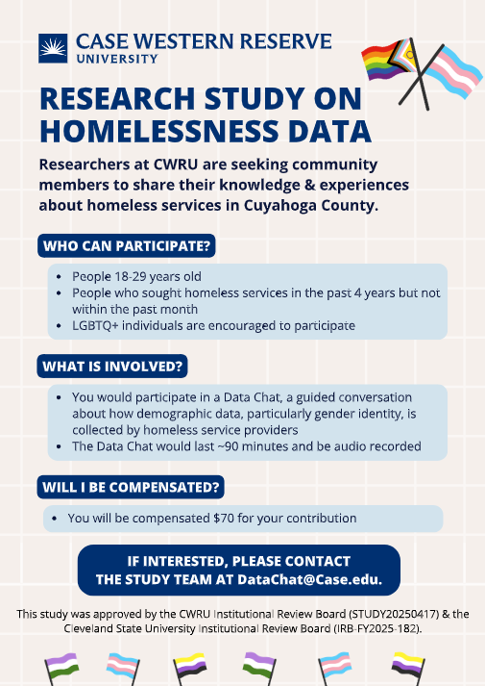
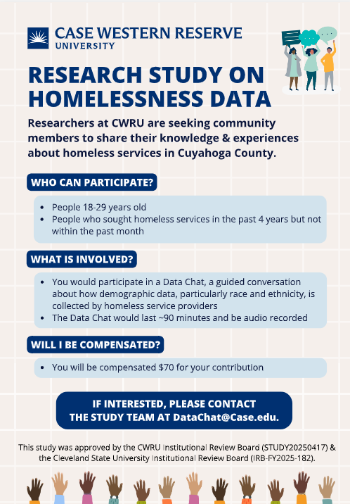
Eliciting Experiential Knowledge: Data Chats to Learn About How Data is Generated
Data Chat:
A method of leveraging experiential knowledge where researcher and people with lived experience share and discuss data
Rooted in the FAIR2 framework for identifying bias in social data science (Richter et al., 2023)
We held two Data Chats in Cleveland, OH, on demographic data collection in homeless services and other administrative systems
Participants were recruited through flyers at community organizations
Participants were young adults with lived experience of homelessness
We share the data discussed followed by participants’ insights
Notes:
One way to tap on the expertise of people represented in data systems is to conduct a Data Chat. A Data Chat is a method of leveraging experiential knowledge where researchers and people with lived experience share and discuss data. Data Chats are rooted in the FAIR2 framework for identifying bias in social data science. To learn more about how demographic data is collected in social service provision, we held two Data Chats in Cleveland, OH. We recruited participants from the Greater Cleveland community using the flyers on the right, and we encouraged young adults with lived experience of homelessness and identifying as racial, ethnic, and gender minorities to participate. In the following slides, we will share some examples of data that we presented to participants, as well as some of the insights that were gathered from their knowledge.

Slide 13
What we shared with Data Chat participants
Summary statistics of data linked across three systems:
Homeless Management Information system (HMIS)
Supplemental Nutrition Assistance Program (SNAP)
Cleveland Metropolitan School District (CMSD)
Individuals in the data:
Ages 18-25 years
Those who interacted with homeless services in Cuyahoga County
2017, 2021 and 2021-2023
When linking records of individuals, how do we cope with different classifications of race and gender id across agencies and over time?
Notes:
Some information that we shared with Data Chat participants included summary statistics of data linked across the three systems that Aaron is in: HMIS, SNAP, school system data. We focused on young adults, like Aaron, aged 18-25. When we linked individuals, we wanted to focus on how we cope with different classifications of race and gender identity across different agencies and across time.

Slide 14
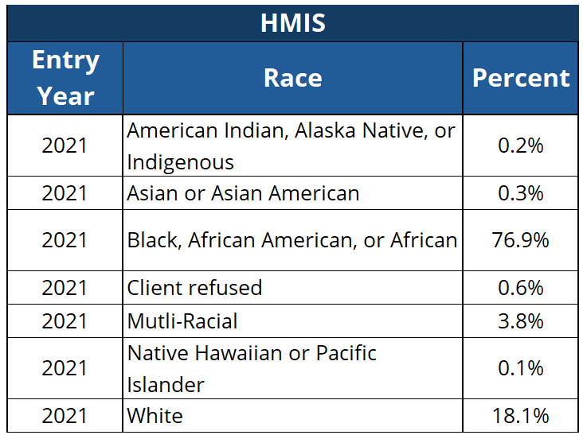
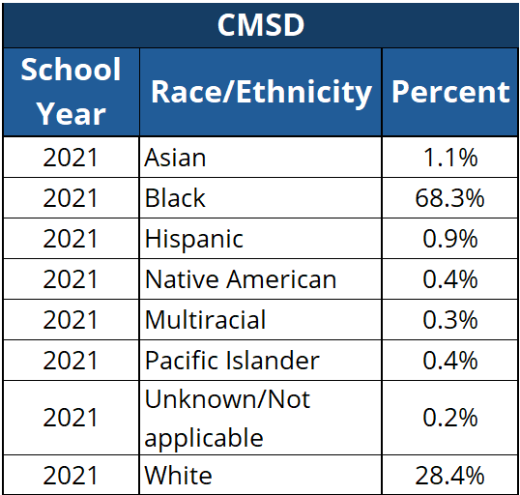
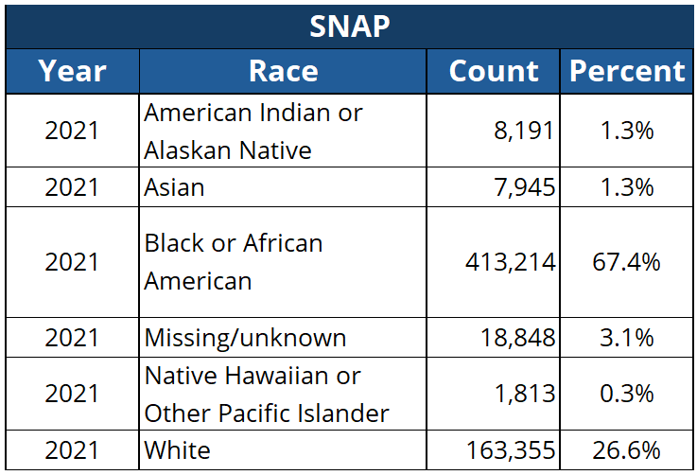
Demographic information is collected in administrative data in different formats and ways across systems
Notes:
Among different agencies, we see that demographic data is collected in different ways. There may be different options available for someone to identify themselves as in the different systems.

Slide 15
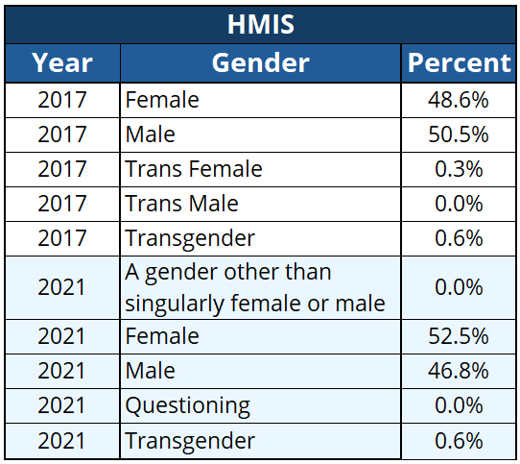
Sometimes classifications change over time within the same agency
Notes:
We also see that those options can change across time in the same system. So here, we see that in HMIS, the options for gender changed from 2017 to 2021. For example, in 2021, there is an option to identify outside of the gender binary, whereas in 2017 all of the options were either female/male or trans female/trans male.

Slide 16
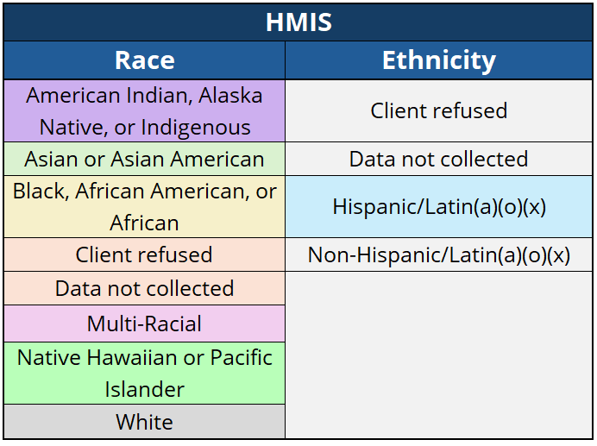
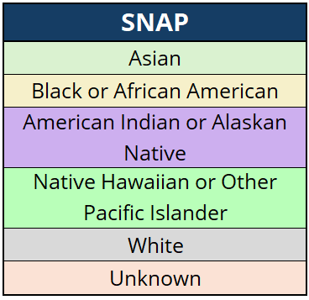
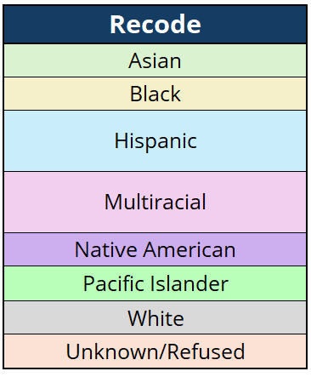
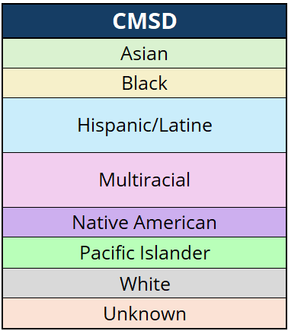
Mapping different demographic categories into standardized, inclusive, common values
We map each agency’s classification into a standardized common categorization that minimizes the loss of inclusive options in the linked data to maximize diverse identities
Notes:
So, when we linked individuals together, the goal is to map each agency’s classification into a standardized common categorization that minimizes the loss of inclusive options in the linked data and maximizes diverse identities.

Slide 17
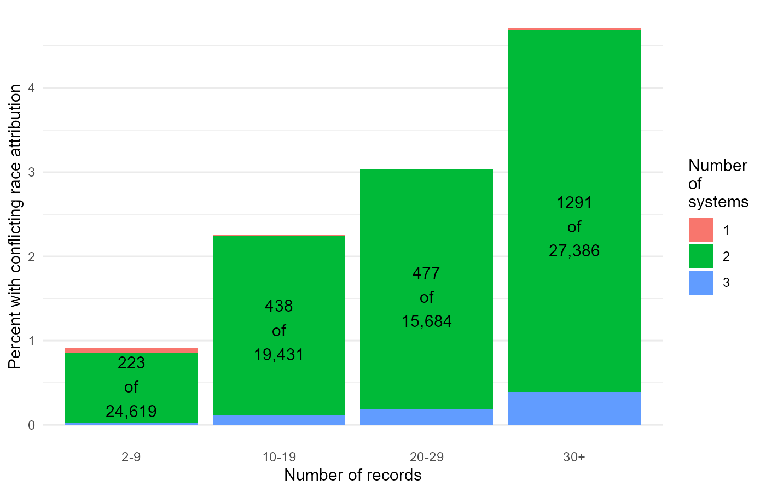
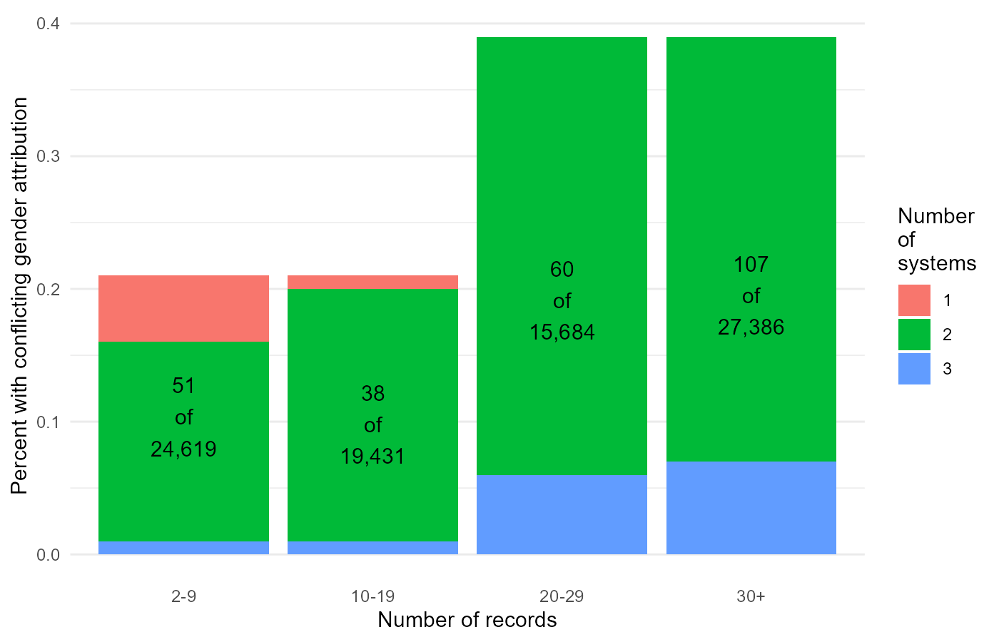
Even after standardizing categories, for some people, demographic information changes across multiple administrative records
Up to 5% with race category mismatch
Up to 0.4% with gender category mismatch
Black/White/Multiracial comprise the majority of cases where race data reporting changes for the same person
Female/male and male/transgender are most common patterns of gender reporting that changes for the same person
Notes:
However, even after we do our very best to do this, we see that there are individuals that have mismatches in demographic data over time. Aaron would be one of these individuals. One the left, we see a small percentage of people that had a mismatch in their race category over time. On the right, we see a small percentage of people that had a mismatch in their gender category over time. For both, we see that an increasing number of records, as well as an increasing number of different agencies that one is involved with, increases the likelihood that we may see these mismatches.

Slide 18
These discrepancies arise for reasons that DC participants helped us uncover or contextualize
Agency-defined demographic categories:
Demographic fields in administrative data are not inherent or fixed characteristics of individuals
Demographic fields represent agency-defined classification schemes rooted in social norms and history that may differ across agencies or change over time
Changes in names due to adoption or identity transition:
Records of people who changed their name due to a change in gender id or adoption will not be linked
These records may be counted as belonging to two different individuals, leading to an undercount representation of trans or gender diverse individuals in the linked data
“That was me. I changed my name” … they kind of give me like a hard time, because then they'd be like. ‘Well, this doesn't match up.’”
“My personal feelings … is that the only thing that needs to be identified is ‘Yes, I’m human.’”
“I feel like I am my own, an entity, and that is good enough for me. So, I never see myself represented on there, and I'm never going to, because they don't put [participant's name] … that's not an identity, right?”
Notes:
Our Data Chat participants—people like Aaron—helped us contextualize why we might see these mismatches and what to do about it. Our first finding was around agency-defined demographic categories. Agencies like homeless shelters, schools, and SNAP, have their own options for how a person can identify themselves. We see that these options are not fixed either, meaning that within the same agency, we see that these options may change over time. This is because agency-defined classifications are rooted in social norms and largely reflect the society in which they were defined. Our second finding was around people who change their name. Our Data Chat participants identified two groups of people who may be more likely to change their name: transgender individuals and individuals who age out of foster care or get adopted. If you remember earlier, we said that we link individuals’ records by their name and date of birth, thinking that these categories are objective. Here, we see that is someone changes their name, we may not be able to link them. Therefore, they may actually appear as two different people in the integrated data system. For trans or gender diverse folks, this likely creates an undercount of that population, while possibly also inflating other categories.

Slide 19
“The worst thing is that you share your information with somebody
and instead of them helping,
they’re judging and categorizing you… And this is the person that’s going to help me, so you’re relying on them to really be trustworthy.”
3. The Data Intake Experience: Data reporting will be impacted by…
What, when and how data is collected
Concerns for safety, stigmatization, service needs
Burden of data collection
We unpack these points with insights and recommendations from participants to ease the burden of data collection and use data in ways that uplifts everyone and promotes community engagement
​“Being on the street, we’re not thinking about the color we are, so why is the government thinking about what color we are?”
Notes:
Our third finding was around the data intake process itself. Data Chat participants helped us realize that there are many factors that influence that process and what data ends up getting reported. We know that people seeking services, who are already in a vulnerable situation, are going to navigate these social service agencies in ways that feel the most safe and least stigmatizing, while also trying to meet their basic needs. Remember how Aaron was grappling with the idea of feeling unsafe at a men’s homeless shelter? This is an example of how Aaron is thinking about how they will get their housing needs met but in the safest way possible. Data Chat participants also highlighted the burden of the data collection process itself. They emphasized that collecting all this additional information is burdensome when people are in such vulnerable situations.

Slide 20
Human choices shape race and gender data at two points: when agencies define the categories on their forms, and when researchers standardize those categories to link records across systems.
Population
Registration & Recording
Databases
Linkage
Integrated Data System (IDS)
Cleaning & Coding
Variables
Person experiencing housing insecurity
Homeless Management Information System (HMIS)
Integrated Data System (IDS) with person-event level data
Race options
Link records using name & date of birth
Standardize race, ethnicity, & gender variables
Student
School system
Ethnicity options
Person experiencing food insecurity
Supplemental Nutrition Assistance Program (SNAP)
Gender options
Table adapted from Shaw et al. (2022)
Notes:
Revisiting this schematic, we see two areas that are ripe for social bias. The first area is in the administrative data systems themselves as agencies define categories on their own forms. The second area is when researchers make decisions on how to clean and standardize all that administrative data as they link records across multiple systems.

Slide 21

Data Chat Participants’ Insights
Given your experience with demographic data collection, what would you suggest to improve the data collection process?
Discussion
Notes:
Now, we’re going to talk a little bit more in depth about what our Data Chat participants shared with us and how that shapes our understanding of integrated data systems. First, we asked participants what they would suggest to improve the data collection process itself.

Slide 22
Data Collection Process
Need for Inclusive & Standardized Options
Standardize Data Collection Process
Improve Training for Providers
Ex. Some forms say “sex,” some say “gender”
Not all identities are represented in options
Self-report vs. provider asking questions
Training on how to ask sensitive questions
Reduce implicit bias
Notes:
Participants called for the need for inclusive and standardized options. They pointed out that some forms can even be confusing, such as only asking for “sex” versus only asking for “gender.” And, participants didn’t always see their identities represented in the options — so how do you answer the questions? Participants also called for a standardized data collection process, noting how some forms were self-reported and some forms were filled out by a provider who asked them questions. Furthermore, sometimes these forms were online, while others were on paper or in-person. Finally, participants emphasized the need for providers to have adequate training on how to ask sensitive questions in the hopes of reducing implicit bias.

Slide 23
Data Intake Experience
Are there situations in the data intake process for homeless services that may cause you to not want to answer to questions about race identity, ethnicity, and/or gender (disclosure of personal information)?
Discussion
Notes:
Next, we asked Data Chat participants if there were any situations in the data intake process that may cause them to NOT want to answer questions about their social identities? Were there any situations that made them uncomfortable disclosing personal information?

Slide 24
Disclosure of Personal Information
Influenced by Safety & Stigma
Affects Receipt of Services
Influenced by Level and Urgency of Need
Decision to disclose personal information (particularly for LGBTQ+ folks) is influenced by safety
Particularly a concern for trans women
“If you’re not a cisgender person, you are looked at as the most dangerous person, but in my eyes, a cisgender person is the most dangerous person to me.”
May not disclose for concern of not receiving adequate services
Oftentimes, documents (i.e., gender marker, name) have to match to receive services
If someone’s needs are high or urgent, they may choose what to disclose based on what they think will get them help fastest
Notes:
We learned that the disclosure of personal information is influenced by safety, stigma, the concern for receiving services, and the level and urgency of someone’s needs. First, Data Chat participants explained that they navigate social agencies in ways that feel safest and least stigmatizing to them. For some folks, that may mean choosing not to disclose certain information about their identities. In fact, it may be a lot safer to choose not to disclose personal information. One of our participants even said, “If you’re not a cisgender person, you are looked at as the most dangerous person, but in my eyes, a cisgender person is the most dangerous person to me.” Next, participants pointed out that disclosing information may depend on what services they are trying to receive, and they may choose what to disclose or not disclose based on what may get their needs met. An important consideration for transgender folks is that their documents must match—remember how Aaron was thinking that their gender marker still said “Male” on all their documents? This may impact how Aaron decides to report their gender identity for fear of their documents not matching their self-report and the impact this has on receiving services. Finally, someone’s level and urgency of need may impact what they disclose—afterall, they are trying to get their basic needs met, things like housing, food, etc.

Slide 25
Data Intake Experience
How important is it to collect these demographic variables? Why?
How does the data intake experience address your needs? Where does it fall short?
Discussion
Notes:
Next, we asked Data Chat participants about the importance of collecting demographic variables. Is it important to collect race, ethnicity, and gender? If so, why? And how does the data intake experience address your needs? Or fall short?

Slide 26
Necessity of Data Collection
Important for Funding
Important in Identifying Gaps
Funding requires organizations to report on who they are servicing
Funds may be available for certain populations, so it’s important to know what populations are serviced
Collecting demographic data can help identify care gaps, which populations are not serviced equally and equitably
“[Race] still plays a huge part. History definitely ties into that because if you were given less from the beginning and then there’s people that were given more, then you’re constantly trying to play catch up in a system that wants you to stay down.”
Notes:
Data Chat participants highlighted two areas where data collection may be important: for funding purposes and for identifying gaps in case. For funding, participants noted that sometimes funding sources themselves require this information. But also, funding is sometimes available for certain populations, so it’s important to know which populations are being serviced. In a similar way, collecting demographic data can help identify gaps in care and identify which populations are not serviced equally and equitably. One of our participants said, “Race still plays a huge part. History definitely ties into that because if you were given less from the beginning and then there’s other people that were given more, then you’re constantly trying to play catch up in a system that wants you to stay down.”

Slide 27
Necessity of Data Collection (Con’t)
Purpose Matters
Could be beneficial if used for positive purposes (i.e., making sure you’re in a safe environment, LGBTQ+ inclusive housing)
People want to know why you’re asking, otherwise it could be a safety concern
Other metrics (support, resources) could be more important than demographics
“When they do the questionnaires, they don’t ask your sexuality, so why is race played into seeking homeless services? Race shouldn’t really be a factor in someone needing shelter or food in their mouth.”
“… When I aged out of foster care, they have all these statistics about foster kids who complete college, who do not complete college, and how many of us are going to end up homeless, right? … What is the point of putting that burden on someone at 18 who's about to venture off? Saying these are the statistics of someone who is like you, who looks like you.”
Notes:
Data Chat participants also noted that the purpose behind collecting this type of information is important. Some participants had positive experiences with collecting information on their LGBTQ+ identities. For example, if the agency if collecting this information to make sure you’re in a safe environment, like LGBTQ+ inclusive housing, then participants found this beneficial. However, if participants did not know why they were being asked these questions, they noted that it could be a safety concern, which we know would lead them to maybe disclose less accurate information. They also noted that other metrics, like current social supports or resources, could be more beneficial than collecting demographics. Ultimately, participants emphasized that the needs are the bottom line. Like one participant said, “Race shouldn’t really be a factor in someone needing shelter or food in their mouth.” Another participant who aged out of the foster care system pointed out the burden that this data can put on children and young adults. They said, “When I aged out of foster care, they have all these statistics about foster kids who complete college, who do not complete college, and how many of us are going to end up homeless, right? What is the point of putting that burden on someone at 18 who is about to venture off? Saying that these are the statistics of someone who is like you, who looks like you…”

Slide 28

Your Advice
We asked Data Chat participants… Based on your experience, what could help reduce discrepancies in data for people facing homelessness?
Notes:
Next, we asked participants for their advice—what could help reduce discrepancies in data for people facing homelessness?

Slide 29
Discrepancies in the Data
Need for Increased Safety
Consider Effect of Social Norms
Safety changes across time and place
Marginalized populations, particularly undocumented immigrants, may not disclose information
“It’s not safe for them, especially undocumented immigrants. It’s not safe for them at all.”
Social pressure to adhere to norms
“Until very recently, the option to be [gender] inclusive was not a thing because our society wasn’t ready for that.”
Binary trans folks may not mark “transgender” especially considering where they are in their medical transition
Notes:
First, participants noted a need for increased safety. Safety changes across time and place and for different populations. Participants emphasized that for some groups, like undocumented immigrants, nearly every place can be dangerous. Social norms also play a part in discrepancies in data. One of the participants said, “Until very recently, the option to be gender inclusive was not a thing because our society wasn’t ready for that.” Social norms change over time and can therefore influence data collection, creating the discrepancies that we sometimes see. Another consideration is that trans folks are a nuanced population — they may not have their documents changed (like Aaron), they may be binary trans (trans male or trans female), they may be nonbinary, they may medically transition, or they may not medically transition. It’s difficult to fit trans folks in a box, like agency forms try to do, so it’s important to note that this population is inherently difficult to capture with the way systems currently collect this type of information. One example that our participants pointed out is that binary trans folks may not even mark “transgender” as an option, especially if they are further along in their medical transition.

Slide 30
Discrepancies in the Data (con’t)
Need for Administrative Consistency
Consider Who is Reporting
Records not always updated by providers
Name changes may cause issues for researchers linking data; could result in both duplication and undercounting (ex. a trans person who changes their name may not be counted in the trans population but may be doubly counted in the binary gender populations
“I don't think the data itself is wrong… we need to do better at getting it more accurate.”
Ex. Some children’s records may be parent-reported and other records may be that same child who has now grown up and is seeking services
Notes:
Next, participants pointed out a need for administrative consistency. Records are not always updated by providers—even if they know that someone’s information has changed. As noted earlier, name changes may lead to an undercount or an overcount of populations when researchers are unable to link records. And finally, some records may be parent- or family-reported when someone is a child, but that same person may show up later in the system as an adult having self-reported information. We saw this with Aaron when their family received some housing assistance and SNAP benefits throughout Aaron’s childhood, but then Aaron also received SNAP benefits as an adult. So for Aaron, we have self-reported information, but we also have parent-reported information.

Slide 31
Your Advice
We asked Data Chat participants… Based on your experience, what could help reduce the burden of data intake for people facing homelessness?
Notes:
Next, we asked Data Chat participants for their advice on what could help reduce the burden of data intake.

Slide 32
Reducing the Burden of Data
You Can’t.
Consider Timing of Data Collection
Provide Resources, Compensation
Data intake is inherently burdensome on marginalized populations
“I’m conflicted because I think my job would want me to believe that it is necessary to get this information. I couldn't really give two F’s about data.”
Collect data when folks are in a safe place (i.e., rehab facility, shelter, soup kitchen)
Provide resources, compensation, food, transportation, etc.
Notes:
Overall, data is inherently burdensome. People seeking services are already in vulnerable situations where their basic human needs are not met in some way. In this way, going through data intake is always going to impart some level of burden, especially for marginalized folks. One of our participants said, “I’m conflicted because I think my job would want me to believe that it is necessary to get this information. I couldn’t really give two F’s about data.” Participants also said the timing of data collection is important. If possible, ask these questions when people are in safer places, like a rehab facility or shelter. If possible, provide resources, compensation, food, transportation and anything else to meet the needs of these folks.

Slide 33
Reducing the Burden of Data (Con’t)
Involve Those with Lived Experience and Shared Identities
Ensure Accessibility
People Behind the Data
Involve folks with lived experience
People may be more comfortable with service providers with shared identities
“Maybe in the future, as youth and young adults lead more of this type of work, my hope is that it does become a lot less burdensome.”
Ensure services are accessible
Ex. Literacy considerations
Service providers may lack a relational component
Clients may feel like “just a number”
“[Providing food or transient support on the frontlines] does provide a certain warmth that there is still someone out there that cares, but at the same time, it’s kind of cruel because you know in the back of your head ‘I need more help than this. But thank you.’”
Notes:
Another important aspect is involving people with lived experience and shared identities. One participant said, “Maybe in the future, as youth and young adults lead more of this type of work, my hope is that it does become a lot less burdensome.” Participants also noted that accessibility is important. For example, consider the literacy of folks and meet them where they are at in providing accommodations. Finally, remember that data represents people and their experiences. Oftentimes, a relational component is lacking—service users are just pushed through systems and feel like numbers on a screen. To this end, one participant said, “Providing food or transient support on the frontlines does provide a certain warmth that there is still someone out there that cares, but at the same time, it’s kind of cruel because you know in the back of your head ‘I need more than this. But thank you.’”

Slide 34
Data Chat Summary
Re: Administrative Data Systems, let’s advocate for:
More inclusive and standard documentation of people’s identities
Provider training so that data intake is sensitive to people in vulnerable situations
Accessibility and safety as standards in service and data intake
When linking administrative data to inform positive social change:
Maximize inclusivity when standardizing categorizations of race and gender identities
Consider the role of society in generating the data we analyze
Who might be missing in the data due to stigma or safety concerns?
Historical context: why are some groups overrepresented in the data?
Remember the people who make up the data
Contextualize numbers with experiences
Data tells someone’s story
Ask for their insights and report back to them
“You’re already in survival mode to where even being at these places [service providers], you kind of just want to run.”
“My personal feelings on it is that the only thing that needs to be identified is ‘Yes, I’m human.’”
Notes:
To summarize, when working with administrative data systems, it’s important to advocate for inclusive and standard documentation of people’s identities, provider training so that data intake is sensitive to people in vulnerable situations, and accessibility and safety as standards in service and data intake. When we are linking administrative data together to inform positive social change, we want to maximize inclusivity when standardizing categorizations of race and gender identities, consider the role of society in generating the data we analyze, and consider the historical context of the data we are using. The bottom line is that behind data are people, and we must remember those who are represented in the data. Seek to contextualize numbers with experiences. Remember that data tells someone’s story. Seek the input and insight of these individuals and foster a collaborative relationship that benefits them.

Slide 35
What parts of Aaron’s story would have been lost if we only had the administrative data?
How can systems work together in ways that would have better supported Aaron?
How would Aaron be represented if…
We only had access to the SNAP data system?
We only had access to the HMIS data system?
We only had used the information their family reported about Aaron when they were a child versus the information Aaron reported about themselves as an adult?
Notes:
Let’s reflect on Aaron’s story. Considering what we’ve talked about today, think about these questions.
What parts of Aaron’s story would have been lost if we only had the administrative data?
How can systems work together in ways that would have better supported Aaron?
Remember how Aaron was worried about going to a men’s shelter versus a women’s shelter? More inclusive shelter spaces, or spaces designed for gender diverse folks may have benefited Aaron.
How would Aaron be represented if…
We only had access to the SNAP data system?
We only had access to the HMIS data system?
We only had used the information their family reported about Aaron when they were a child versus the information Aaron reported about themselves as an adult?

Slide 36
“I feel like people are eager to share their experience if people are willing to listen.”
Notes:
As you reflect on Aaron’s story, remember that part of your responsibility as a social worker, a researcher, or anyone part of a team that uses social data is to best represent the people and experiences in the data. As one of our Data Chat participants said, “I feel like people are eager to share their experience if people are willing to listen.”

Slide 37
References
Shaw, R. J., Harron, K. L., Pescarini, J. M., Pinto Junior, E. P., Allik, M., Siroky, A. N., Campbell, D., Dundas, R., Ichihara, M. Y., Leyland, A. H., Barreto, M. L., & Katikireddi, S. V. (2022). Biases arising from linked administrative data for epidemiological research: a conceptual framework from registration to analyses. European journal of epidemiology, 37(12), 1215–1224. https://doi.org/10.1007/s10654-022-00934-w
Richter, F.; Nelson, E.; Coury, N.; Bruckman, L.; Knighton, S. (2023). FAIR2: A framework for addressing discrimination bias in social data science. Editorial Universitat Politècnica de València. 327-335. https://doi.org/10.4995/CARMA2023.2023.16400
Notes:
Create graphic with four boxes

